Slide 1

TATYASAHEB KORE INSTITUTE OF ENGINEERING AND TECHNOLOGY, WARANANAGAR [AN AUTONOMOUS INSTITUTE] DEPARTMENT OF COMPUTER SCIENCE & ENGINEERING

Slide 2
Project Title: Process Scheduling
Presented by:
Name Roll No
Namrata Medidar 105
Sanyogita Patil 116
Susmita Janawade 119
Guidance : Prof Mrs. B. A. Chougule

Slide 3
Introduction:
CPU scheduling is the basis of multi programmed operating systems. By switching the CPU among processes, the operating system can make the computer more productive. This project introduce basic CPU-scheduling concepts and present several CPU-scheduling algorithms and also consider the problem of selecting an algorithm for a particular system.
The objective of multiprogramming is to have some process running at all times, to maximize CPU utilization. The idea is relatively simple. A process is executed until it must wait, typically for the completion of some I/O request. In a simple computer system, the CPU then just sits idle. All this waiting time is wasted; no useful work is accomplished. With multiprogramming, here try to use this time productively.
Thus the project overcomes this problem using scheduling algorithms by scheduling the processes. Several processes are kept in memory at one time. When one process has to wait, the operating system takes the CPU away from that process and gives the CPU to another process. This pattern continues. Every time one process has to wait, another process can take over use of the CPU. Scheduling of this kind is a fundamental operating-system function.

Slide 4
Problem Statement:
In a single-processor system, only one process can run at a time; any others must wait until the CPU is free.

Slide 5
First Come First Serve Algorithm
First come first serve scheduling algorithm states that the process that requests the CPU first is allocated the CPU first. It is implemented by using the FIFO queue. When a process enters the ready queue, its PCB is linked onto the tail of the queue. When the CPU is free, it is allocated to the process at the head of the queue. The running process is then removed from the queue. FCFS is a non-preemptive scheduling algorithm.
First come first serve suffers from convoy effect.

Slide 6
Round Robin Algorithm
Each process is assigned a fixed time(Time Quantum/Time Slice) in cyclic way.It is designed especially for the time-sharing system. The ready queue is treated as a circular queue. The CPU scheduler goes around the ready queue, allocating the CPU to each process for a time interval of up to 1-time quantum. To implement Round Robin scheduling, we keep the ready queue as a FIFO queue of processes. New processes are added to the tail of the ready queue. The CPU scheduler picks the first process from the ready queue, sets a timer to interrupt after 1-time quantum, and dispatches the process. One of two things will then happen. The process may have a CPU burst of less than 1-time quantum. In this case, the process itself will release the CPU voluntarily. The scheduler will then proceed to the next process in the ready queue. Otherwise, if the CPU burst of the currently running process is longer than 1-time quantum, the timer will go off and will cause an interrupt to the operating system. A context switch will be executed, and the process will be put at the tail of the ready queue. The CPU scheduler will then select the next process in the ready queue.

Slide 7
Shortest Job First Algorithm
Process which have the shortest burst time are scheduled first. If two processes have the same bust time then FCFS is used to break the tie. It is a non-preemptive scheduling algorithm.
Shortest Job first has the advantage of having a minimum average waiting time among all operating system scheduling algorithms.It is associated with each task as a unit of time to complete.It may cause starvation if shorter processes keep coming.

Slide 8
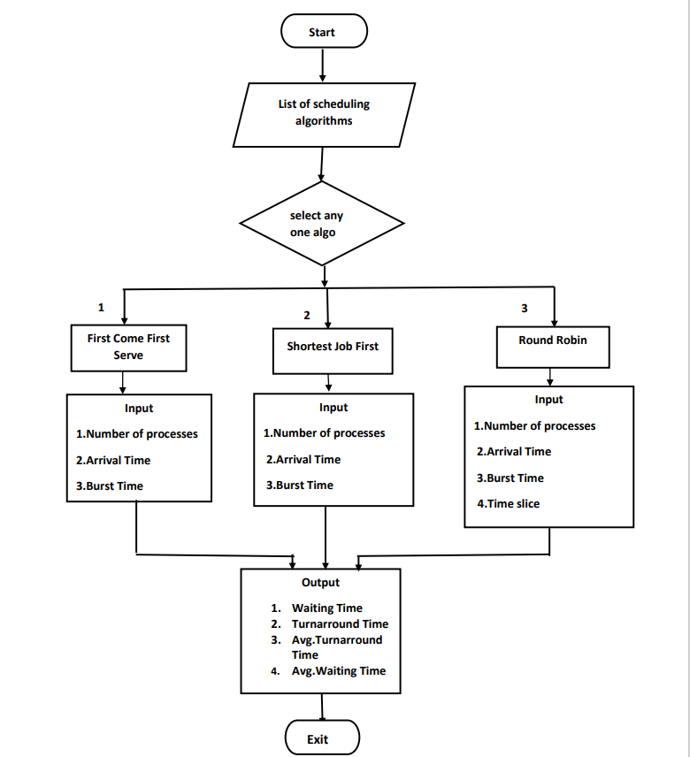
Flowchart

Slide 9
Input:
Input is process ID, Arrival Time, Burst Time, Quantum/Time slice.Then select the type of algorithm for scheduling.
Output:
When user gives the input that is process details and after selecting the type of algorithm for scheduling, then the output contains the waiting time, turnaround time for each process and also the average waiting and turnaround time for selected type of scheduling algorithm.

Slide 10
Requirements:
Hardware Requirements:
• Processor :- 8086 Family onwords
• RAM :- 128 MB &above
• HDD :- 10 GB &above
Software Requirements
Platform : Windows
Programming Language :- C
Compiler :- GCC (GNU C Compiler
IDE : Codeblocks

Slide 11
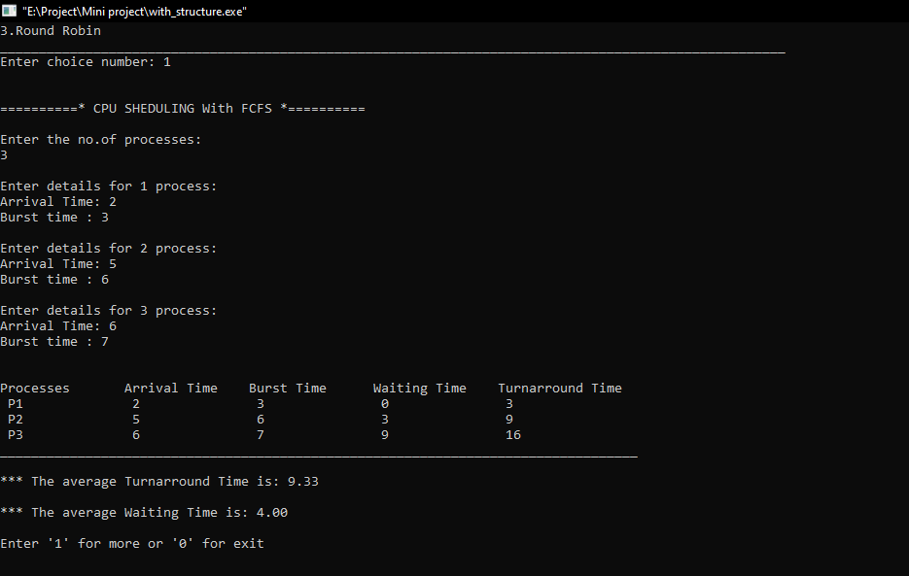
User Manual

Slide 12
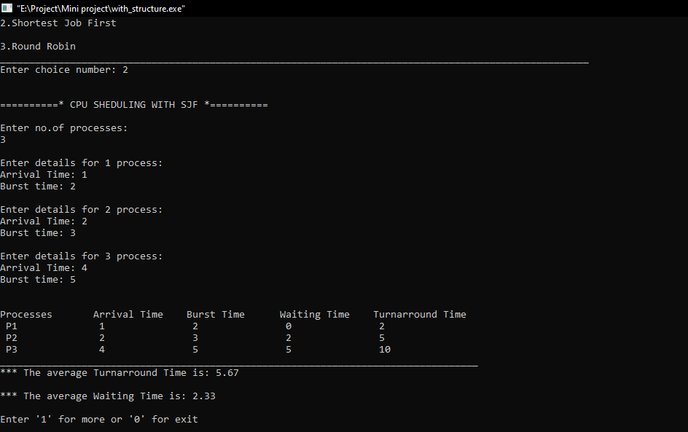

Slide 13
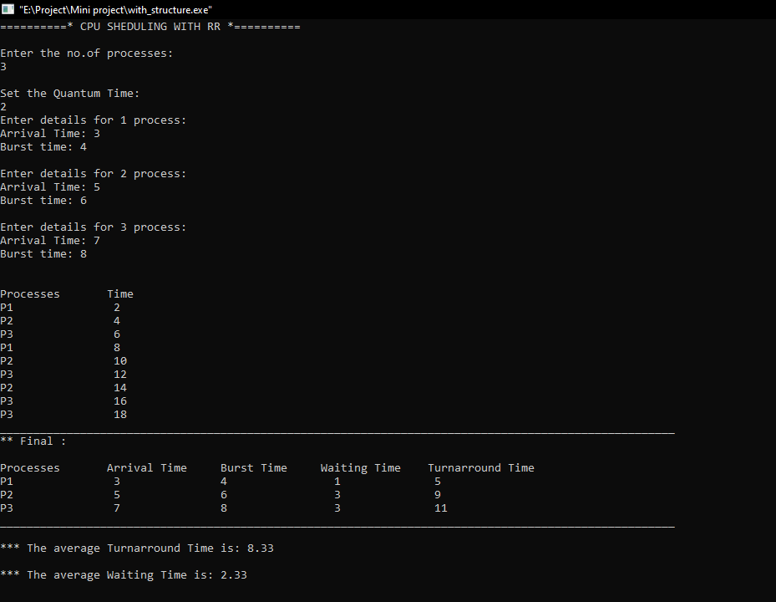

Slide 14
Conclusion
The treatment of shortest process in SJF Scheduling tends to result in increased waiting time for long processes. And the long process will never get served, though it produces minimum average waiting time and average turnaround time. It is recommended that any kind of simulation for any CPU scheduling algorithm has limited accuracy.

Slide 15
References
Books
1. [1] Silberschatz, A. P.B. Galvin and G. Gagne (2012), Operating System Concepts, 8th edition, Wiley India,
2. The complete reference C - 4th edition - herbert schildt
Websites
1. https://www.geeksforgeeks.org/cpu-scheduling-in-operating-systems/
2. https://www.tutorialspoint.com/operating_system/os_process_scheduling.htm

